Slide 1
Atopic Dermatitis (Eczema)

Slide 2
A family of disorders
Etiologic/morphologic variants | Regional variants
Atopic dermatitis | Hand eczema
Contact dermatitis | Face/eyelids
Irritant | Lips
Allergic | Scalp
Nummular eczema | Diaper dermatitis
Lichen simplex chronicus | Stasis dermatitis
Notes:
All demonstrate the histological hallmark of spongiosis, which helps to distinguish the eczemas from papulosquamous diseases such as psoriasis.

Slide 3
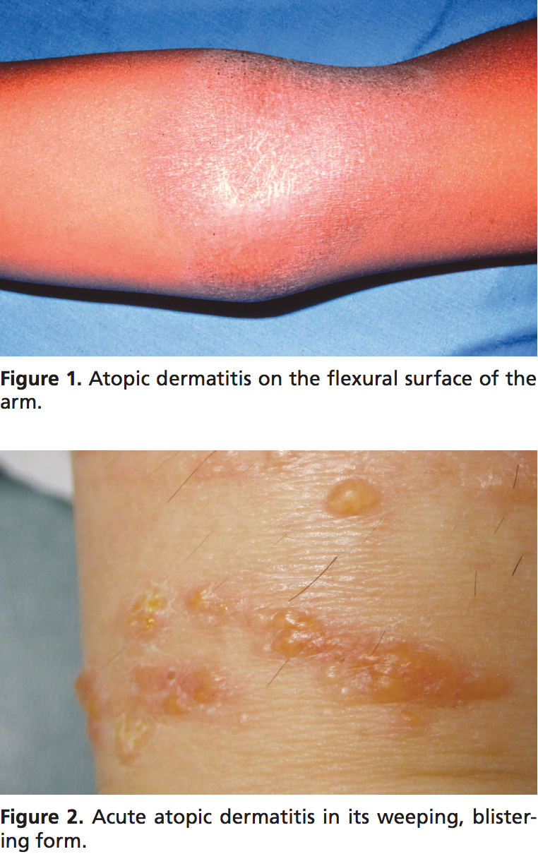
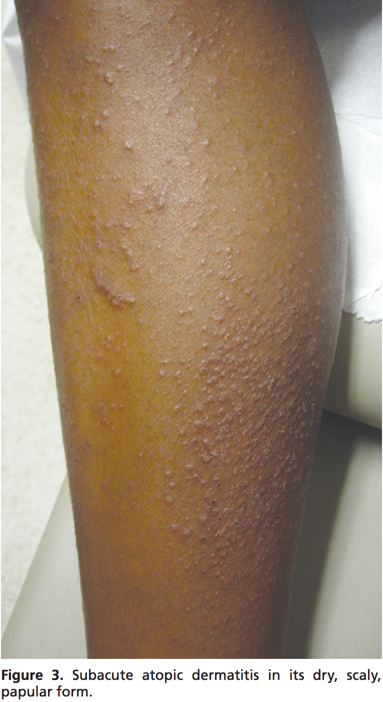
Clinical Presentation
Notes:
characterized by pruritic, erythematous, and scaly skin lesions often localized to the flexural surfaces of the body

Slide 4
Prevalence
Impacts 15 – 30% of children
Only 2 – 10% of adults
Children tend to outgrow eczema
Up to 30% of children with eczema will develop asthma later in life
Asthma arises in only 1 – 18% of the general population

Slide 5
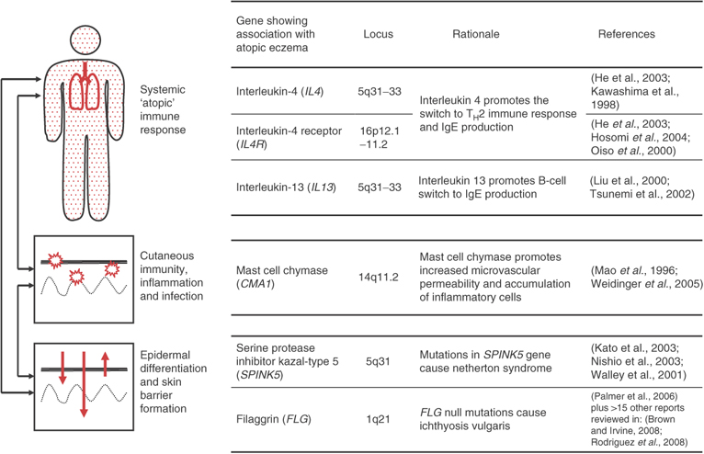
Eczema genetics
doi:10.1038/jid.2008.413

Slide 6
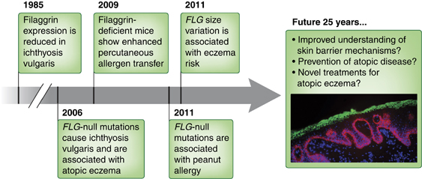
The role of filaggrin
doi:10.1038/jid.2011.393

Slide 7
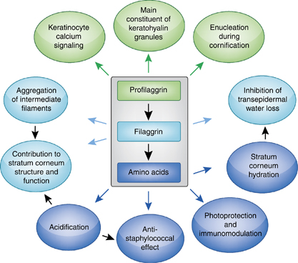
The role of filaggrin
doi:10.1038/jid.2011.393

Slide 8
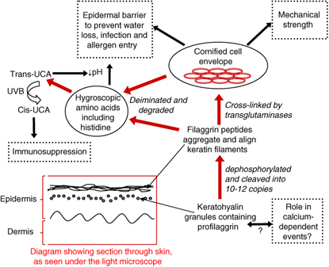
The role of filaggrin
doi:10.1038/jid.2008.413
Notes:
Profilaggrin is expressed in the granular layer
Profilaggrin is proteolytically cleaved in the uppermost granular cells to produce filaggrin peptides that aggregate and align keratin filaments within the cytoskeleton of keratinocytes
Filaggrin is deiminated and degraded with a half-life of 6 hours (Candi et al., 2005), to release hygroscopic amino acids

Slide 9
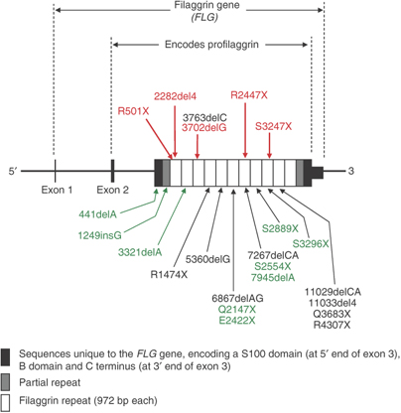
FLG mutations
doi:10.1038/jid.2008.413
Notes:
FLG is located on chromosome 1q21, within the epidermal differentiation complex, a cluster of genes controlling the terminal differentiation of keratinocytes
The mutations marked in red are prevalent in the European population, with a combined allele frequency of 0.09. The mutations marked in black are found in European and European American populations at much lower frequencies. The mutations marked in green have been identified in ichthyosis vulgaris and eczema cases from Chinese, Japanese, and Singaporean Chinese populations.

Slide 10
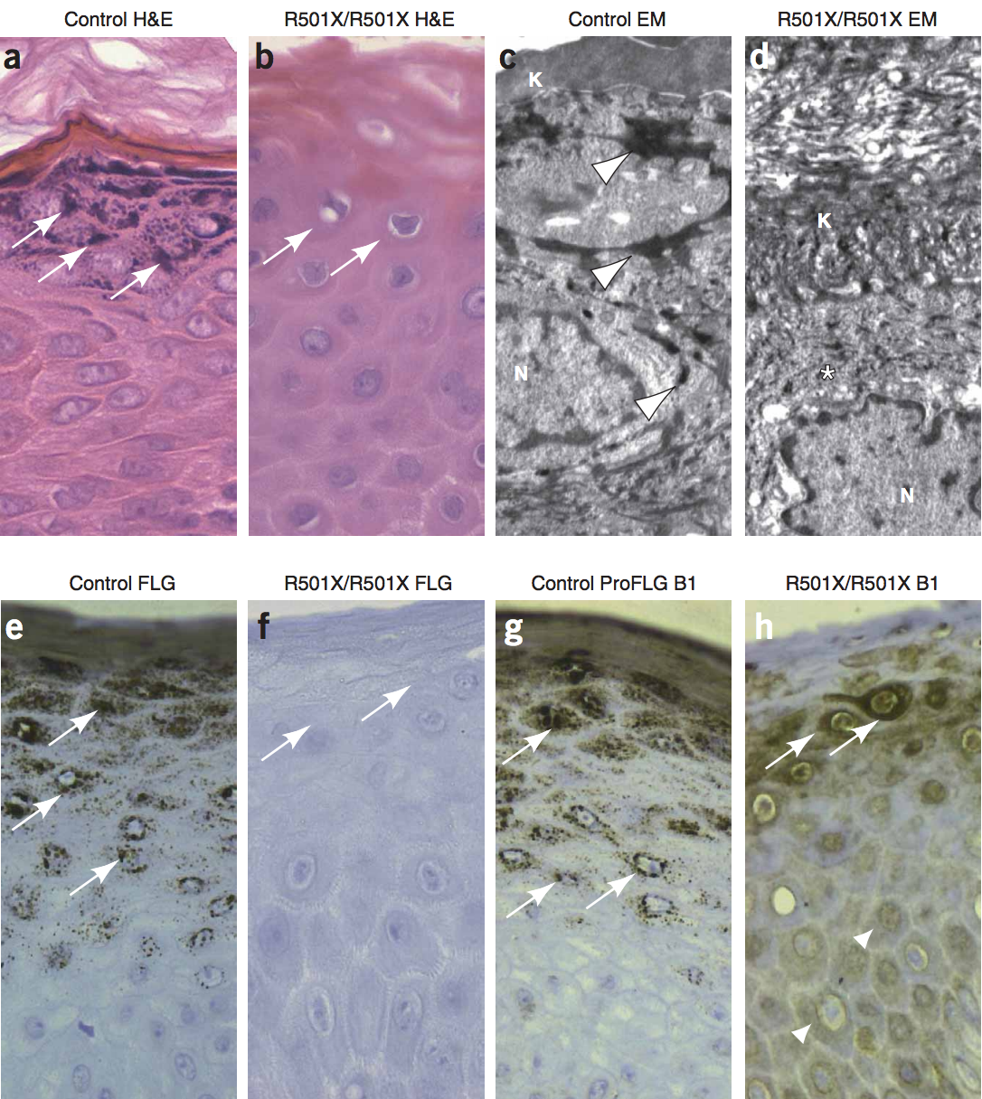
Filaggrin-null morphology
doi:10.1038/ng1743
Notes:
A – control
B – complete absence of keratohyalin granules
C – electron microscope control
D – TEM absence of keratohyalin granules
E,F – IHC staining for filaggrin
G,H – IHC staining for profilaggrin

Slide 11
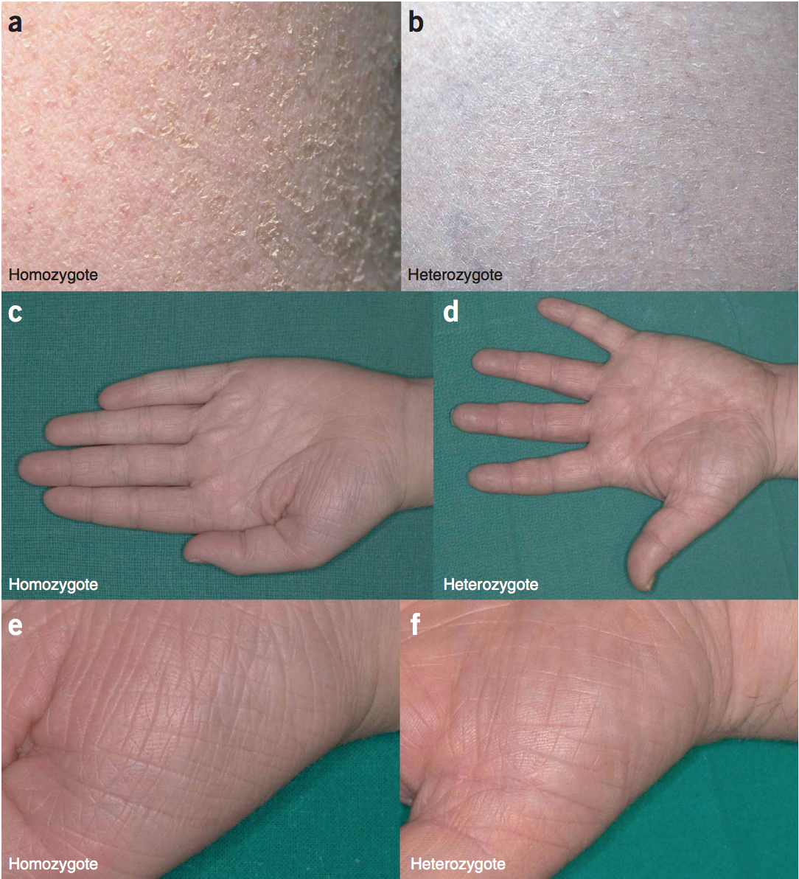
The role of filaggrin
doi:10.1038/ng1743

Slide 12
Is filaggrin enough?
“[F]ilaggrin haploinsufficiency is an important and significant component in the pathogenesis of a proportion of eczema cases but it cannot be used to explain the majority of eczema, even in most of the severe case series.”
doi:10.1038/jid.2008.413

Slide 13
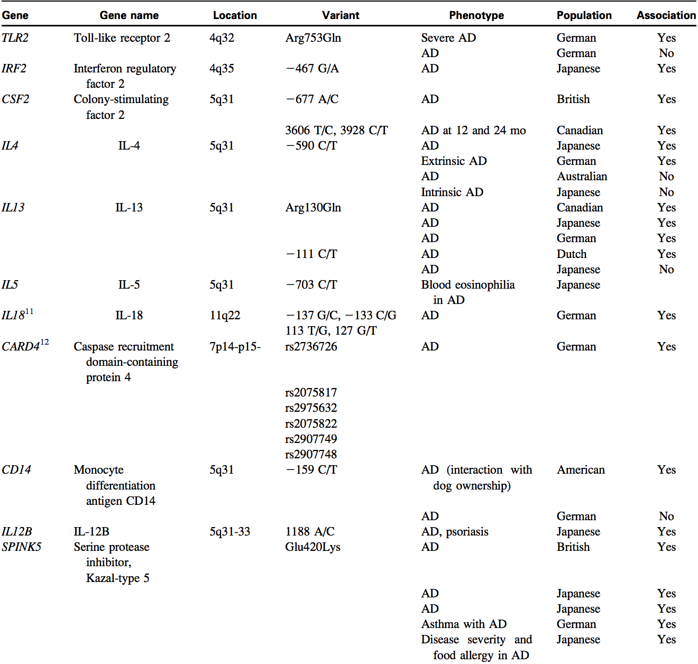
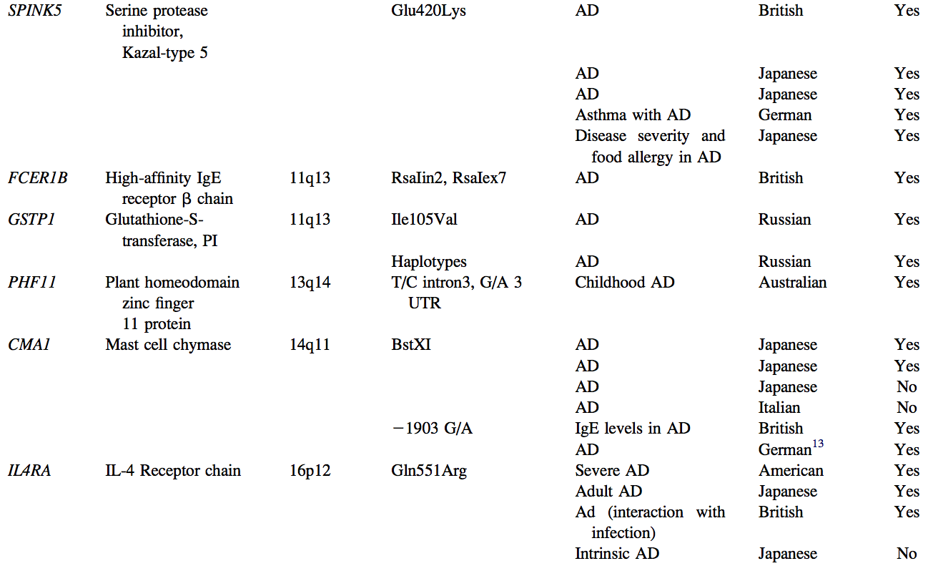
Candidate genes for AD
doi:10.1016/j.jaci.2006.03.045

Slide 14
T-cell cytokines in AD
AD patients have increased circulating levels of T-cells
Onset strongly associated with production of Th2 cytokines (IL-4, IL-13, IL-31)
Cytokine milieu transitions from Th2 to Th1 as AD progresses from acute to chronic
doi:10.1038/jid.2009.71

Slide 15
Th17 lymphocytes in AD
IL-17 mRNA preferentially associated with acute lesions among AD patients
Higher concentrations circulating in blood of AD patients
Th17 cells are present in the skin of AD; exact role remains unknown
doi:10.1038/jid.2009.71

Slide 16
T-reg cells in AD
Increased CD4+ CD25+ T cells in peripheral blood of AD patients
Overexpression of FOXP3
FOXP3+ natural T-reg cells undetectable in skin
doi:10.1038/jid.2009.71

Slide 17
Dendritic cells in AD
IgE-bearing FcεRI+ inflammatory epidermal dendritic cells are prominent in chronic lesions
Promote Th1 cytokine production from T cells
May contribute to switch from the Th2 response in acute AD to Th1 in chronic?
doi:10.1038/jid.2009.71

Slide 18
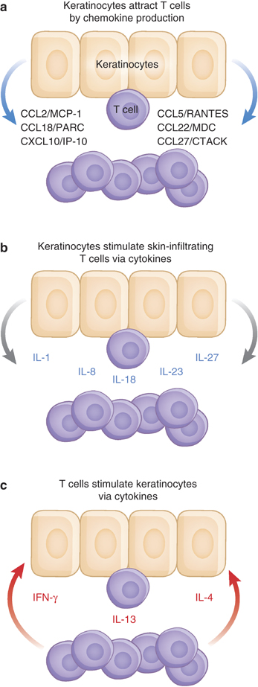
Keratinocyte-T-cell interactions
Sources of cytokines such as the T-cell growth factor IL-15 in the skin
Respond to both Th1 and Th2 cytokines from T cells
Important regulatory role in epidermal diseases/inflammatory responses
doi:10.1038/jid.2009.71

Slide 19
IgE immunoreactivity
80% of AD patients have increased IgE levels
Remaining 20% generally show late AD onset
IgE-mediated histamine release from cutaneous mast cells may aggravate AD
Greater IgE-mediated sensitization correlates with more severe AD, but no causal link
doi:10.1038/jid.2009.71

Slide 20
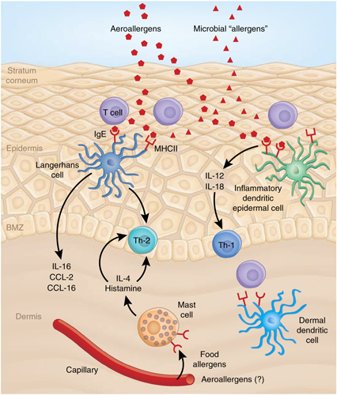
Effects of allergens
doi:10.1038/jid.2009.71
Notes:
highlights only some key mediators of AD
—the Th2 cytokine IL-4 and histamine in the acute phase and
—Th1-related cytokines IL-12 and IL-18 in the chronic phase.
A number of other mediators are currently being investigated
—IL-17 and IL-31 representing extensively studied cytokines with regard to AD at present.
More knowledge of these factors may contribute to the development of specific approaches for phase-dependent therapies in this chronic relapsing skin disease.

Slide 21
Treatment
Some benefits seen among infants weaned on probiotic-supplemented formula
Typically managed first with moisturizing creams
May be supplemented with corticosteroids
doi:10.1046/j.1365-2222.2000.00943.x

Slide 22
References
Akdis, C., Akdis, M., Bieber, T., Bindslev-Jensen, C., Bouguniewicz, M., Eigenmann, P., et al. (2006). Diagnosis and treatment of atopic dermatitis in children and adults: European Academy of Allergology and Clinical Immunology American Academy of Allergy, Asthma and Immunology/PRACTALL Consensus Report. Journal of Allergy and Clinical Immunology, 118, 152–169.
Berke, R., Singh, A., & Guralnick, M. (2012). Atopic dermatitis: an overview (PDF). American Family Physician, 86, 35–42. PMID 22962911.
Brown, S., & McLean, W. (2009). Eczema genetics: Current state of knowledge and future goals. Journal of Investigative Dermatology, 129, 543–552.
Brown, S., & McLean, W. (2012). One remarkable molecule: Filaggrin. Journal of Investigative Dermatology, 132, 751–762.
Hanifen, J. (2009). Evolving concepts of pathogenesis in atopic dermatitis and other eczemas. Journal of Investigative Dermatology, 129, 320–322.
Isolauri, E., Arvola, T., Sutas, Y., Moilanen, E., & Salminen, S. (2000). Probiotics in the management of atopic eczema. Clinical and Experimental Allergy, 30, 1604 – 1610.
Saito, Hirohisa (2005). Much atopy about the akin: Genome-wide molecular analysis of atopic eczema. International Archives of Allergy and Immunology, 137, 319–325. doi:10.1159/000086464. PMID 15970641.
Smith, F., Irvine, A., Terron-Kwiatkowski, A., Sandilands, A., Campbell, L., Zhao, Y., et al. (2006). Loss-of-function mutations in the gene encoding filaggrin cause ichthyosis vulgaris. Nature Genetic,s 38, 337–342.
Tollefson, M., & Bruckner, L. (2014). Atopic dermatitis: Skin-directed management. Pediatrics, 134, e1735–44. PMID 25422009.
Werfel, T. (2009). The role of leukocytes, keratinocytes, and allergen-specific IgE in the development of atopic dermatitis. Journal of Investigative Dermatology, 129, 1878–1891.

